Slide 1

Penyiapan Narrative Review Article
Yang saya Pahami
Yang saya anut
Yang saya lakukan
Abdul Rohman
Fakultas Farmasi
Universitas Gadjah Mada
Email: abdulrohmanugm@gmail.com

Slide 2
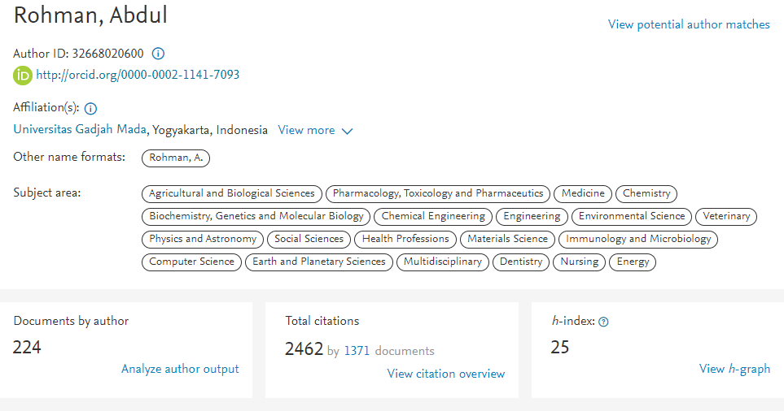
PROFIL SCOPUS

Slide 3

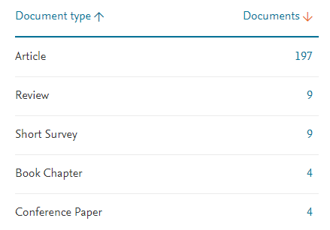
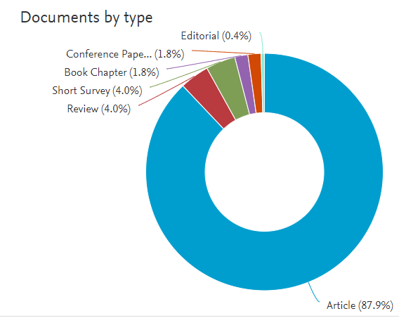
PROFIL SCOPUS

Slide 4
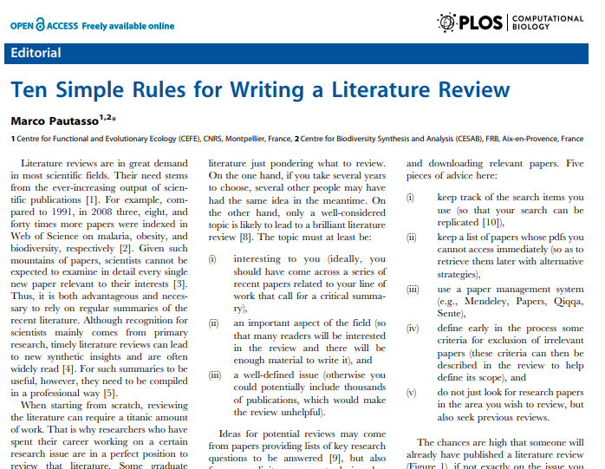
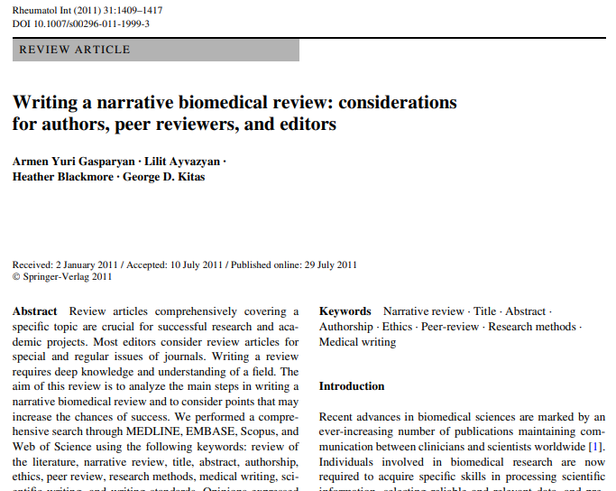
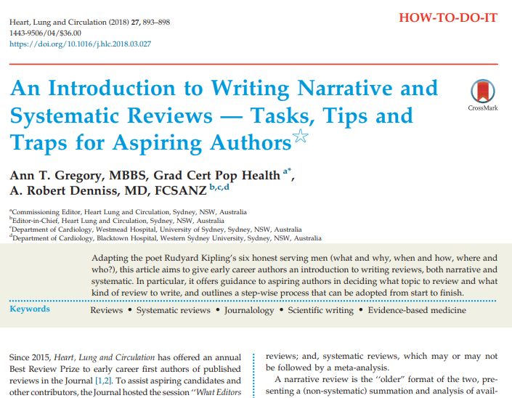
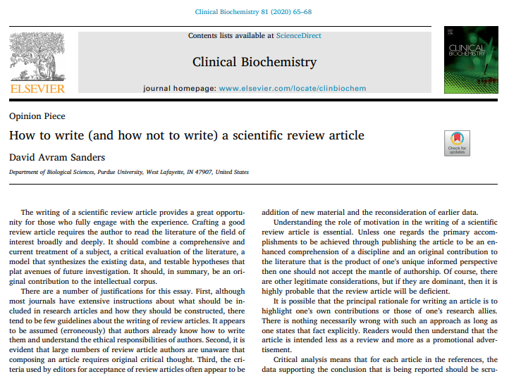
REFERENCES

Slide 5
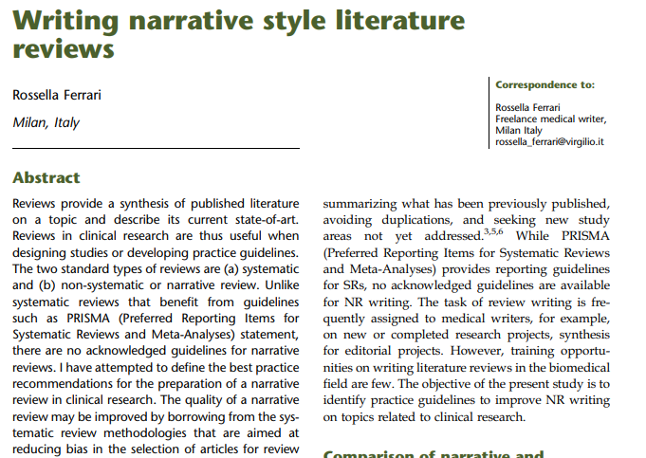
R.F. Baumeister, M.R. Leary. “Writing narrative literature reviews”. Med. Writ. 2015. 24(4): 311–320. 10.1037/1089-2680.1.3.311.

Slide 6

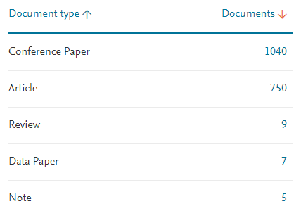
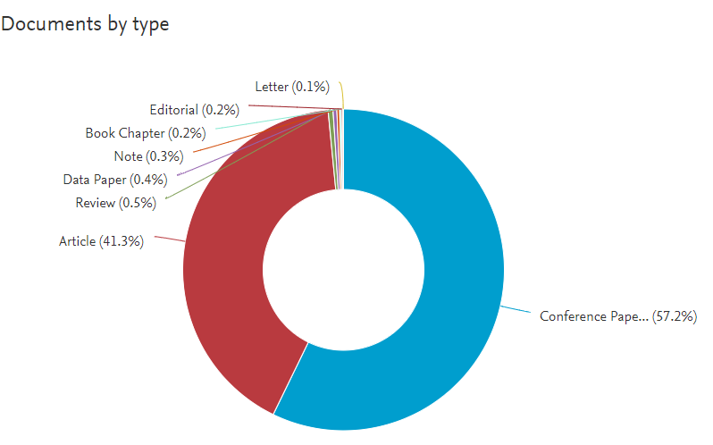
UNIVERSITAS NEGERI YOGYAKARTA

Slide 7

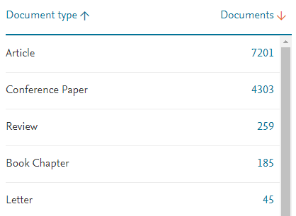
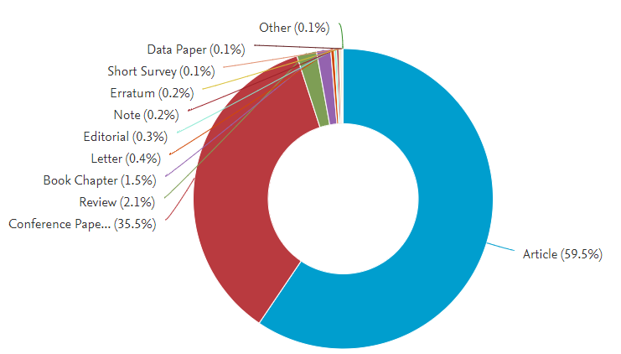
UNIVERSITAS GADJAH MADA

Slide 8

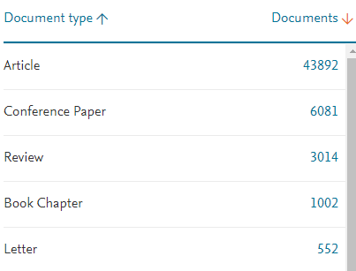
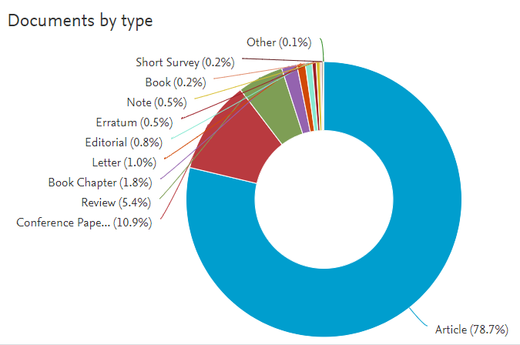
UNIVERSITI MALAYA

Slide 9
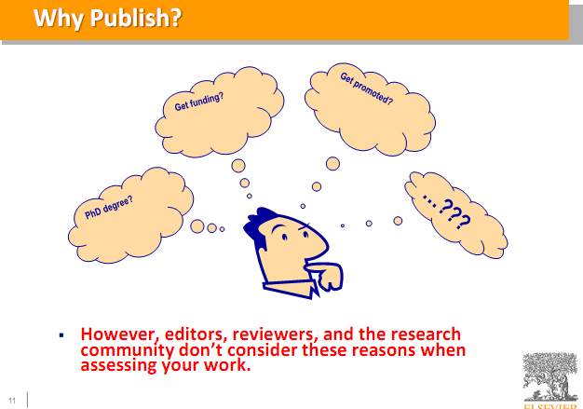
MOTIVASI PUBLIKASI

Slide 10
REVIEW ARTICLE DALAM KARYA TULIS ILMIAH
Karya ilmiah dapat disampaikan ke publik dalam berbagai bentuk
  Hasil penelitian di laboratorium (bengkel, studio, puskesmas, lapangan, RS) → karya original article/Short communication
  Hasil pemikiran dalam suatu topik tertentu → Review article
  Hasil pengamatan terhadap kasus spesifik → case reports
  Sanggahan atas artikel yang sudah terbit → Letter to Editor

Slide 11
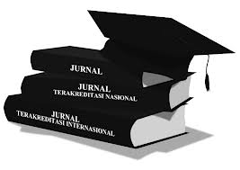
JENIS ARTIKEL
Original Research Article
Short communication
Review Article
Letter to Editor
Case reports
Editorials

Slide 12
Original Research Article
Full-length original research articles follow a standard format that is the prototype for scientific writing and typically include:
  Introduction,
  Methods,
  Results, and
  Discussion
Although length may vary, original articles should contribute substantive new information with a clear major focus.
Beberapa jurnal membagi lanjut menjadi: full length original research dan short communication

Slide 13
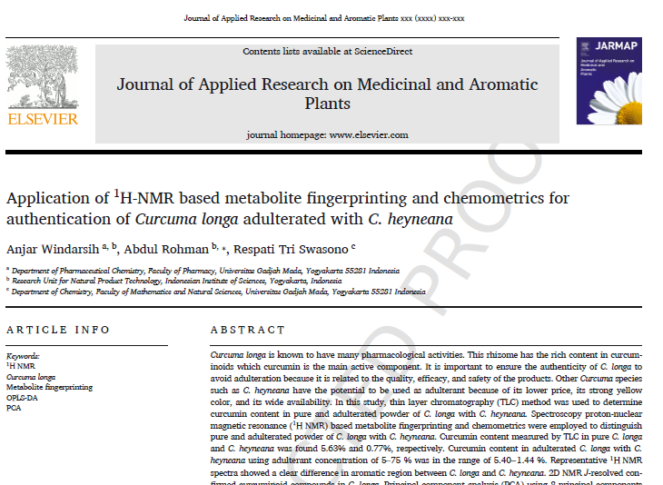
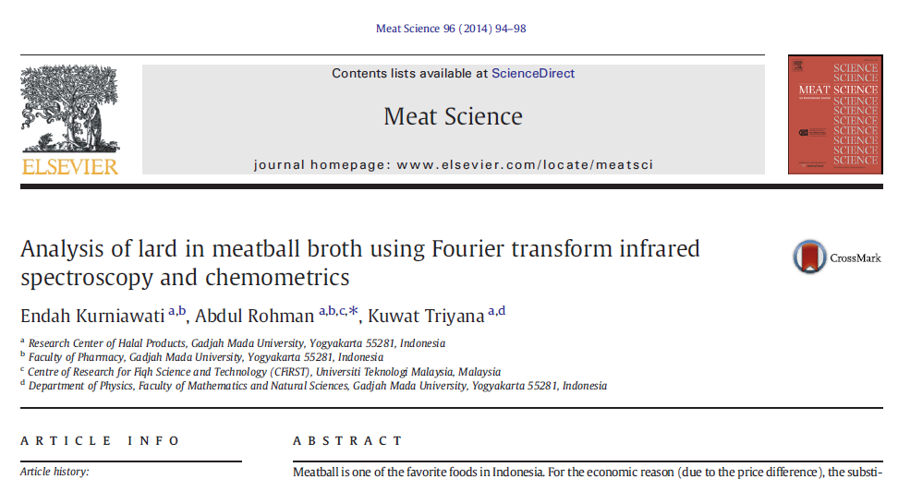
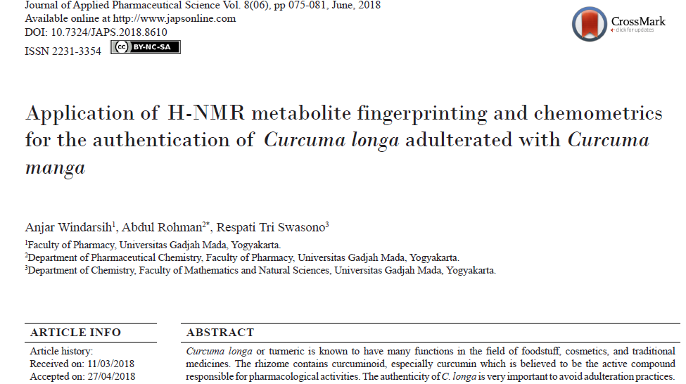
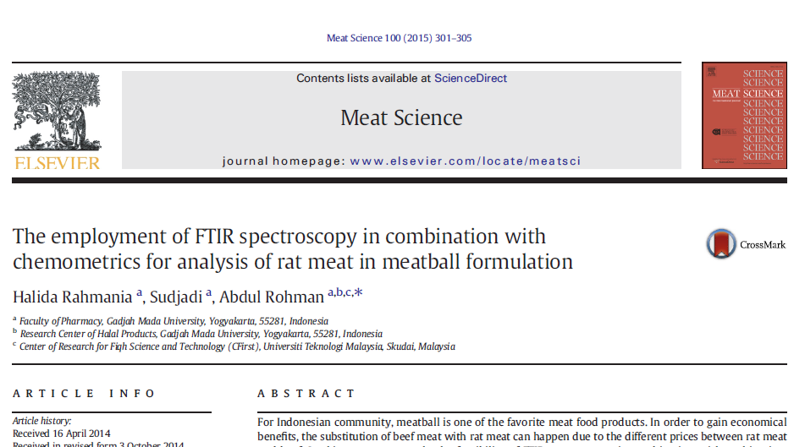
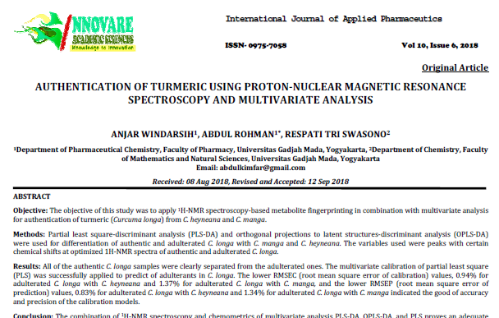
Original Research

Slide 14
SHORT COMMUNICATION
Short communications describe limited or preliminary original research and are appropriate when the amount of new information and methods don’t warrant a full-length article.
Mempunyai originalitas yang tinggi
Suatu artikel apakah masuk di full length article atau short communication, tergantung pada keputusan Editor.
Ada beberapa jurnal yang di awal memang menyediakan pilihan short communication.
Aturan yang umum: artikel secara data belum memenuhi jadi full article, akan tetapi novelty sangat tinggi.

Slide 15
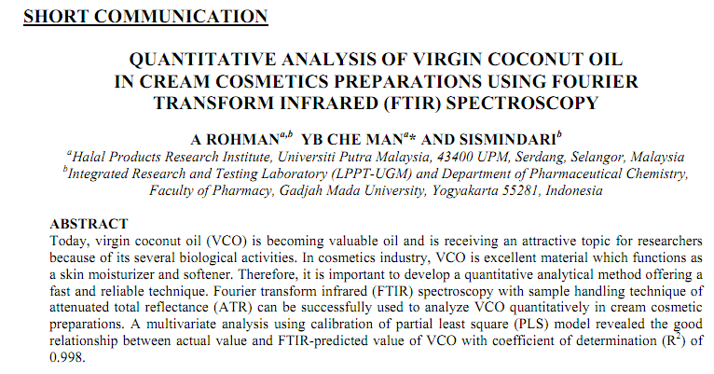
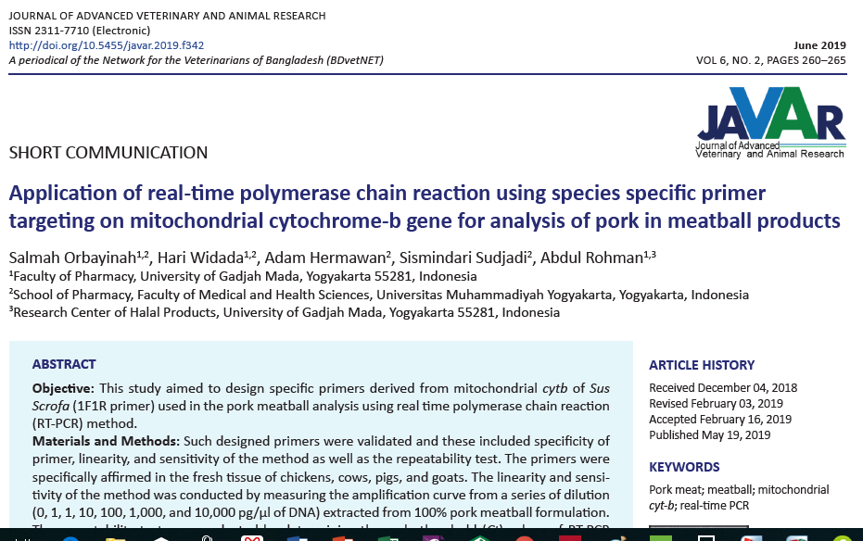
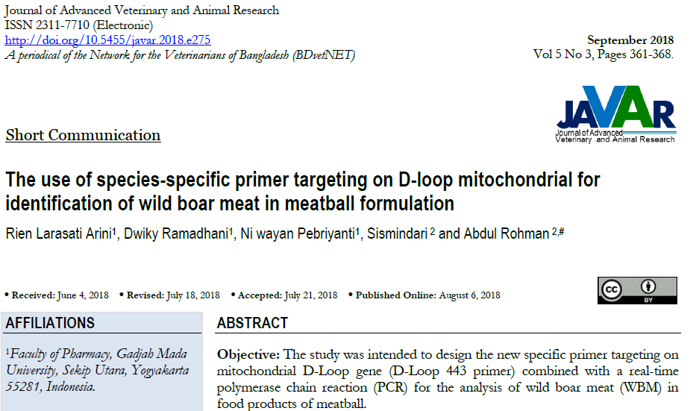
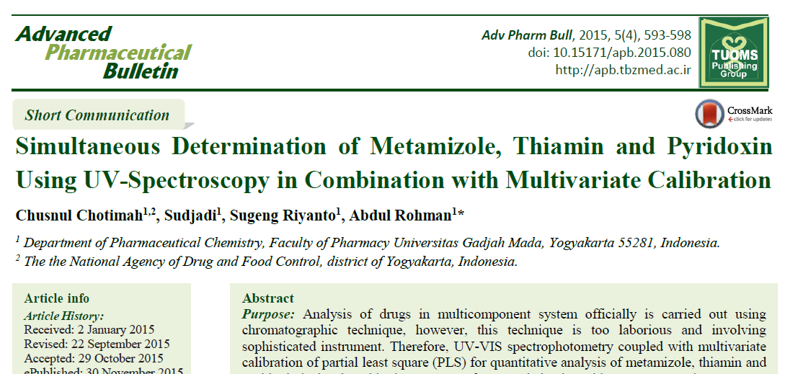
SHORT COMMUNICATION

Slide 16

Publikasi Artikel Review
Bisa di-invite oleh Editor in Chief atau Associate Editor, atau apapun jabatan Editorial apapun di jurnalnya.
Author juga bisa secara active menawarkan artikelnya.
Bisa disubmit ke journal yang khusus review atau journal umum → Lihat instruction for Authorsdan Scope jurnal yang dituju

Slide 17
KEUNTUNGAN Artikel Review
Tingkat sitasinya tinggi → beberapa journal melakukan call for article dalam bentuk review untuk meningkatkan sitasi/impact factor
Tidak tergantung pada ketersediaan research grant
Dapat dilakukan dimanapun, kapanpun dan keadaan apapun
Dapat penulis tunggal

Slide 18
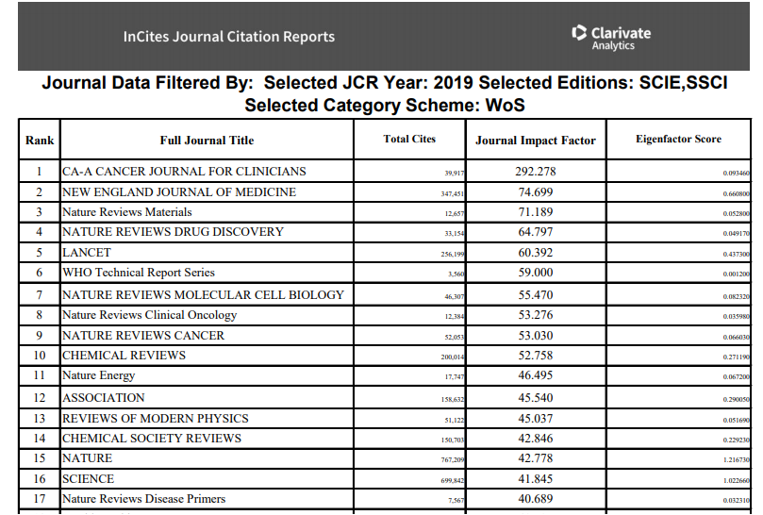
REVIEW: TINGKAT SITASI TINGGI

Slide 19
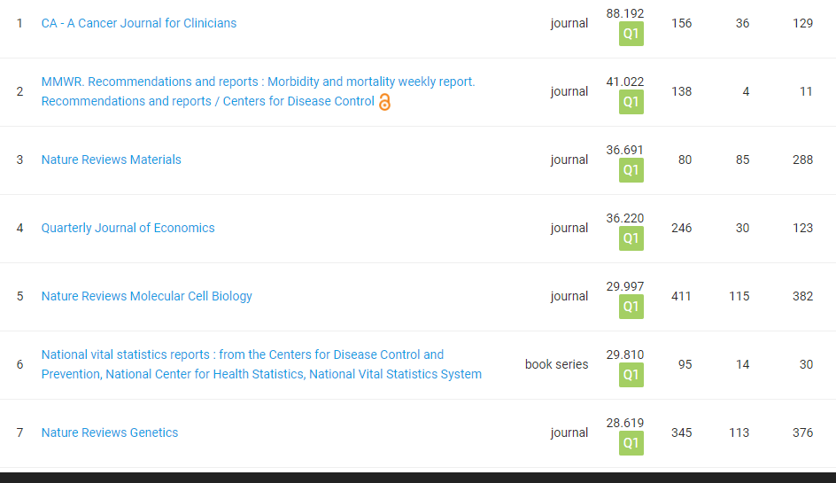
REVIEW: TINGKAT SITASI TINGGI

Slide 20
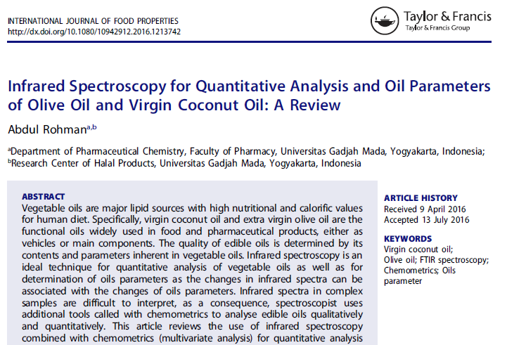
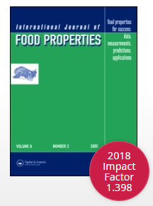
Impact factor = 1.398

Slide 21

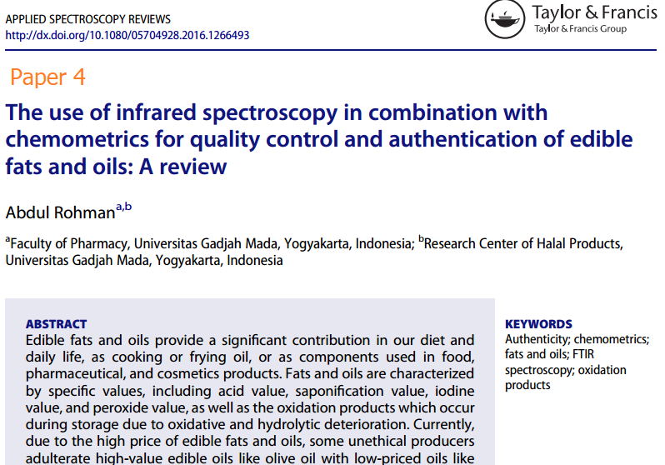
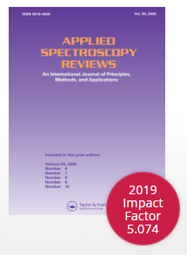

Slide 22
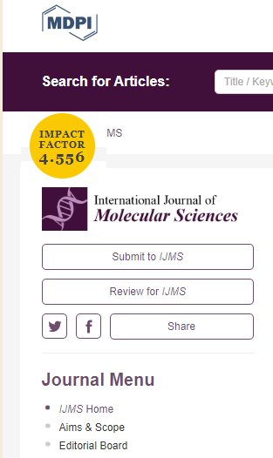
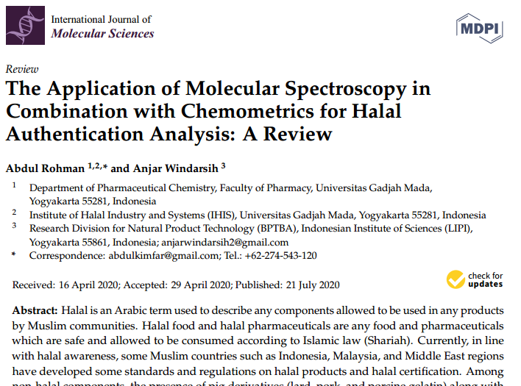

Slide 23
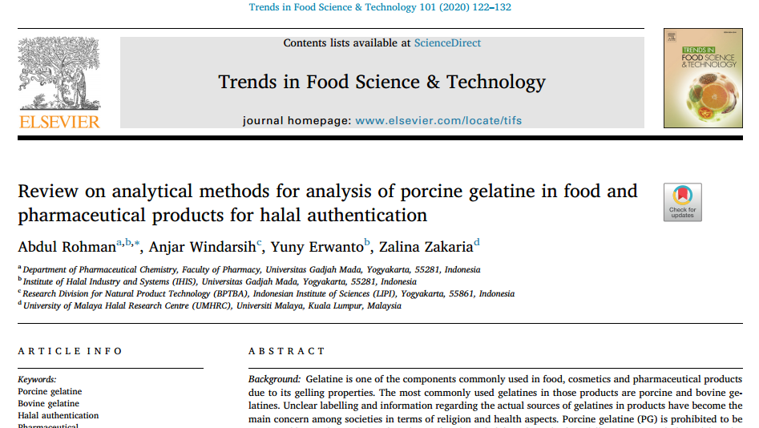
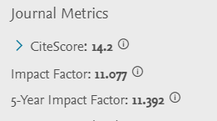
JENIS REVIEW ARTICLE
Narrative review (non-systematic review)
Systematic review

Slide 25
LETTER TO EDITOR
Letters to the editor respond to a previously published article, report an observation, or raise an issue relevant to readers;
Most editors-in-chief welcome them.
Letters are indexed and citable and provide an important public forum for discussing divergent views
Editors reserve the right to publish or reject a letter based on content and professional presentation.

Slide 26
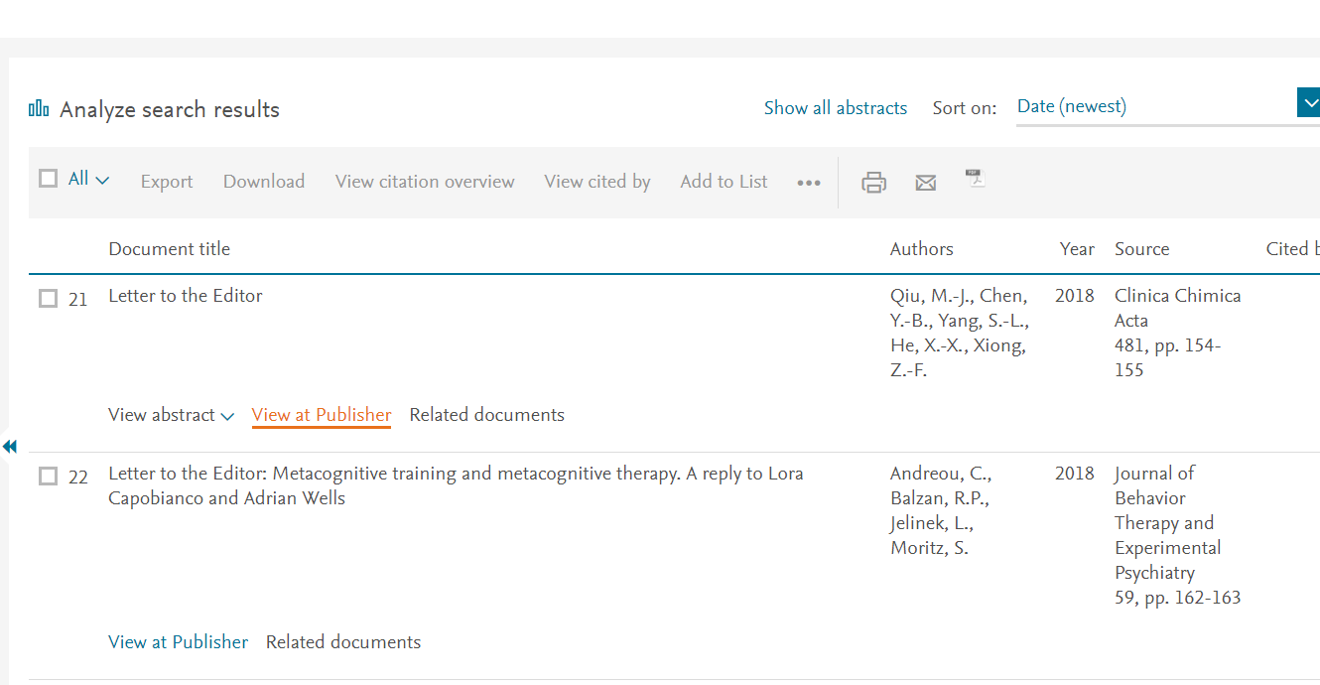
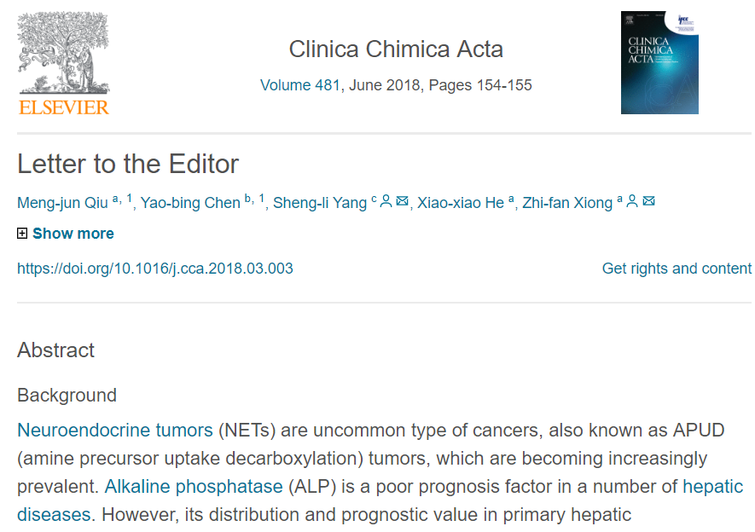
SITASI DAN INDEKSASI: LETTER TO EDITOR
Jika jurnal yang memeuat Letter to Editor terindeks Scopus, maka Letter to Editor akan muncul di Scopus seperti jenis artikel yang lain

Slide 27
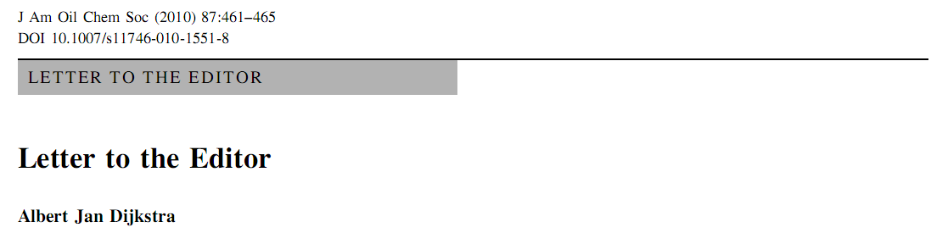
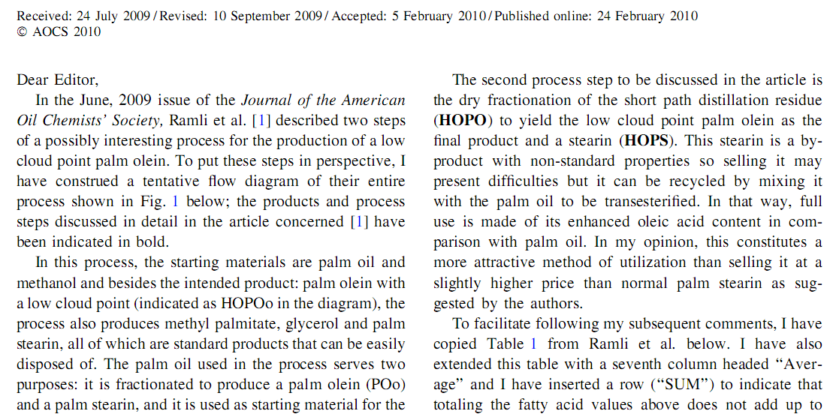
LETTER TO EDITOR
Tulisan A.J. Dijkstra memberikan komentar terhadap tulisan Ramli yang dipublikasikan di jurnal yang sama

Slide 28
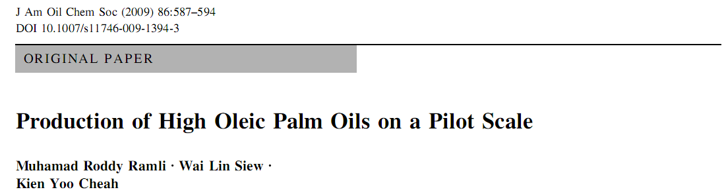
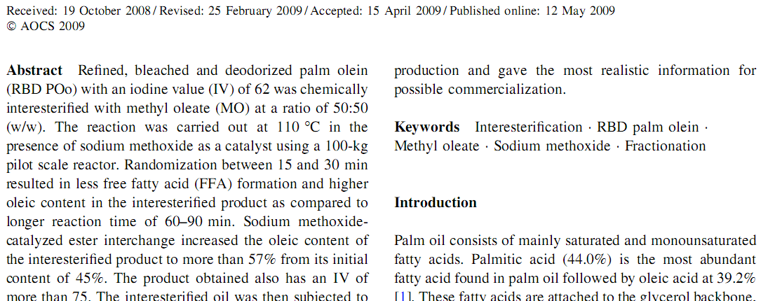
PAPER YANG DIKOMENTARI

Slide 29
WHAT IS REVIEW?
Simply put, reviews do not present new data but do provide an assessment of what has already been published or presented.
There are two standard types of reviews:
  narrative reviews, also known as traditional or non-systematic reviews
  systematic reviews, which may or may not be followed by a meta-analysis.

Slide 30
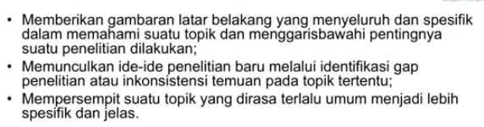
MANFAAT STUDI LITERATUR

Slide 31
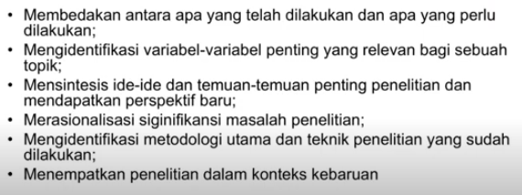
TUJUAN LITERATUR REVIEW

Slide 32
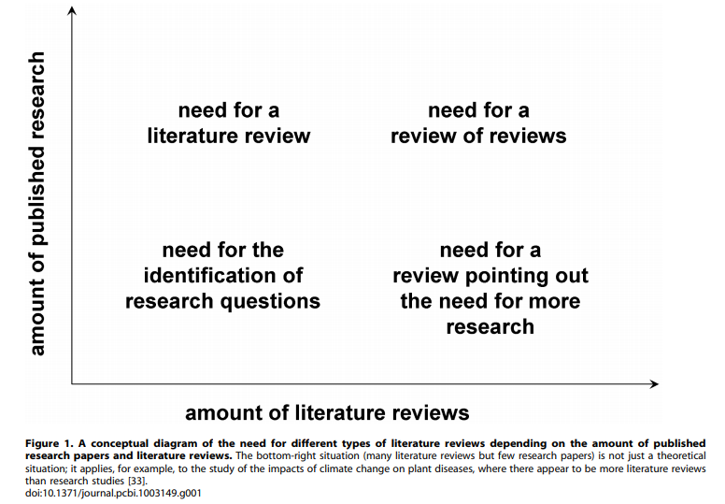
Pautasso’s graph:
What would you like us to write about?

Slide 33
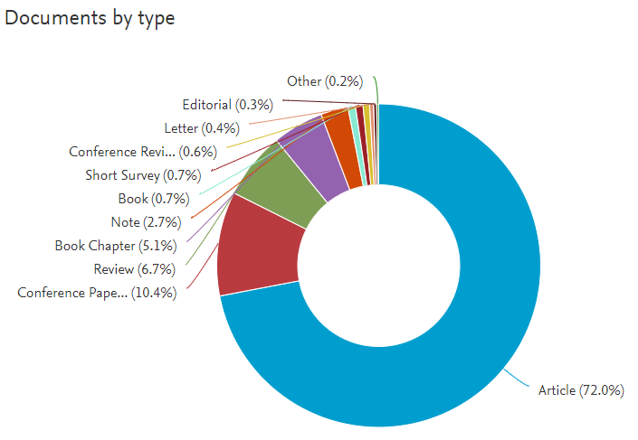
JENIS ARTIKEL: KATA KUNCI HALAL

Slide 34
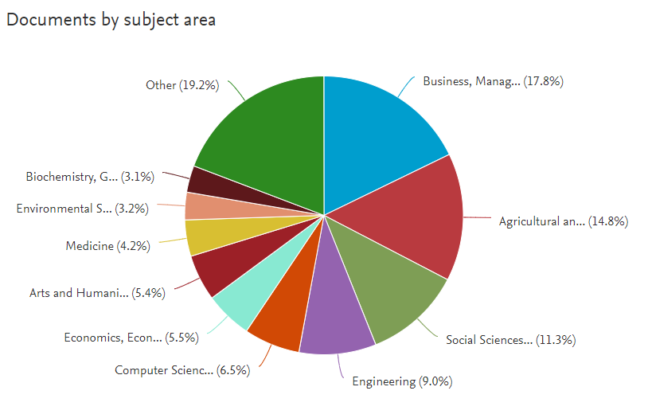
BIDANG ILMU

Slide 35
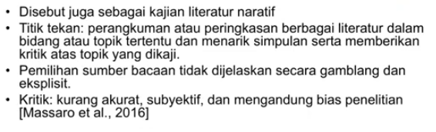
NARRATIVE REVIEW

Slide 36
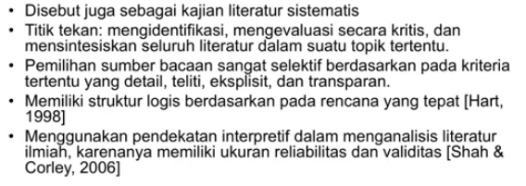
SYSTEMATIC REVIEW

Slide 37
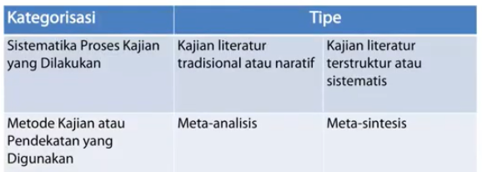

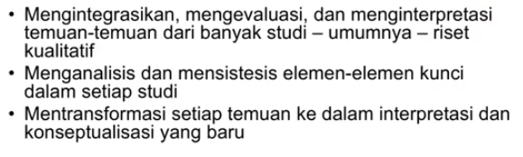

Slide 38

META ANALYSIS

Slide 39

TEKNIK BIBLIOMETRIK

Slide 40

Where Do We Begin?

Slide 41

TEN SIMPLE RULES FOR WRITING LITERATURE REVIEW
(PLoS, Comput Biol 2013;9:e1003149).
Rule 1: Define a Topic and Audience
Rule 2: Search and Re-search the Literature
Rule 3: Take Notes While Reading
Rule 4: Choose the Type of Review You Wish to Write
Rule 5: Keep the Review Focused, but Make It of Broad Interest
Rule 6: Be Critical and Consistent
Rule 7: Find a Logical Structure
Rule 8: Make Use of Feedback
Rule 9: Include Your Own Relevant Research, but Be Objective
Rule 10: Be Up-to-Date, but Do Not Forget Older Studies

Slide 42

FIVE SIMPLE STEPS FOR WRITING REVIEW ARTICLE
Step 1: Define Topic and Audience
Step 2: Search and Re-Search the Literature
Step 3: Be Critical
Step 4: Find a Logical Structure
Step 5: Reviewing Your Review

Slide 43


Slide 44


Slide 45

Step 1: Define Topic and Audience
select a topic that is also of interest to others (editors, readers and researchers)
ensure that there is enough data in the literature to meet your needs to conduct a review but not so much data

Slide 46

Step 2:
Search and Re-Search the Literature
Identify the most relevant literature in your selected topic area, generally via keyword searches on relevant electronic databases, such as, but not only, PubMed, Scopus, Web of Science, etc
When searching the literature, used appropriate keywords

Slide 47

Step 3: Be Critical
‘‘stop” at just summarizing the literature: as Pautassos wrote, ‘‘reviewing the literature is not stamp collecting”.
Not only summarise the relevant literature but to also analyse it, to provide a critical discussion of it, and to identify methodological problems in reviewed studies or knowledge gaps.

Slide 48

Step 4: Find a logical structure

Slide 49
Step 5: Reviewing Your Review
Make use of feedback in revising your review before formal submission to a journal.
Ensure your review is clear and accurate; that it does not have any ambiguities, inaccuracies or inconsistencies.
We suggest you invite others to read your work — from native English speakers to peers to senior colleagues.

Slide 50
STRUKTUR ARTIKEL REVIEW
ORIGINAL ARTICLE
REVIEW ARTICLE
Cover letter
Title page
Abstract (including keywords)
Introduction
Materials and methods
Results and discussion
Conclusion
Acknowledgement (if any)
References
Supplementary data
Cover letter
Title page
Abstract (including keywords)
Introduction
Methods (literature searching)
Body Sections
Conclusion
Acknowledgement (if any)
References

Slide 51

General framework of narrative reviews
R.F. Baumeister, M.R. Leary. “Writing narrative literature reviews”. Med. Writ. 2015. 24(4): 311–320. 10.1037/1089-2680.1.3.311.

Slide 52
General framework of narrative reviews

Slide 53

COVER LETTER

Slide 54

CONTOH COVER LETTER

Slide 55

DECLARATION OF MANUSCRIPT HISTORY

Slide 56


TITLE PAGE
PADA TITLE PAGE BIASANYA DITULIS
  Judul
  Penulis dan alamat lembaga di mana penelitian dilakukan
  alamat penulis korespondensi (Tel, fax, email)

Slide 57


TITLE PAGE: REVIEW ARTICLE

Slide 58
TITLE OF MANUSCRIPT
Together with the abstract, the title is the most frequently read part of your article and used in database searches.
Readers often use the title to decide whether to read an article, so titles should be:
  accurate, informative, and representative (not misleading).
  Be descriptive, use specific terms, and avoid abbreviations and proprietary names.
Some journals request a short title (running title) to use in the page header of the article.

Slide 59
‘‘How” to Title Your Work?
Clear titles, understandable by non-experts
Titles posed as questions are also well accepted, as they may draw readers’ attention
It has been suggested that titles assist editors in selecting peer reviewers for your work; and, perhaps most importantly.
Articles with titles that convey a specific and accurate description of manuscript content are more likely to be cited

Slide 60
‘‘Who” Will Author Your Review?
All co-authors must meet the International Committee of
Medical Journal Editors (ICMJE) authorship criteria:
Substantial contributions to conception and design,
acquisition of data, or analysis and interpretation of data;
Drafting the article or revising it critically for important,
intellectual content, and
Approval of the final version.

Slide 61

ABSTRACT

Slide 62
ABSTRACT AND KEYWORDS
A review abstract should contain few words (100–250)
A structured abstract, with concise information on the main
sections of the manuscript, is preferable.
  The background,
  aim,
  literature search strategy
  the statement of messages stemming from literature analysis and conclusion.
  The conclusion.
A limited number of keywords is another critical part of a review, contributing to the chances to be retrieved and cited by
other authors
It may also be required to add keywords reflecting the essence of the manuscript.

Slide 63

ABSTRACT TERSTRUKTUR
Mengandung lebih informasi
Lebih mudah dibaca
Lebih mudah dicari bagian-bagiannya
Memudahkan reviewer untuk mereview-nya
Nyaman baik bagi penulis maupun pembaca

Slide 64


Slide 65

ABSTRACT TIDAK TERSTRUKTUR

Slide 66


Slide 67
INTRODUCTION
The introduction needs to be written in a way to reflect novelty and previous similar attempts to comprehensively cover the topic
It is suggested that introduction contain:
  Objek utama yang akan dikenai review
  Motivasi melakukan review
  Pentingnya melakukan review terkait objek
  Perlu dilakukan analisis kesenjangan sehingga memotivasi untuk melakukan review
  Cakupan yang akan dikenai review
  Tujuan review merupakan jawaban pertanyaan review

Slide 68

TUJUAN REVIEW
Menentukan body context yang akan dibahas
Bagaimana body context?
BAGAIMANA BODY CONTEXT-NYA?

Slide 69
Methods: review
Penyarian literatur
  Penentuan kata kunci (keywords) untuk penyarian literatur
  Gunakan database (Scopus, PubMed, Google Scholar, dll)
Selection criteria (inklusi dan eksklusi)
Critical assessment

Slide 70
LITERATURE SELECTION PROCESS

Slide 71

PRISMA Flow Diagram
The Preferred Reporting Items for Systematic Reviews and Meta-Analyses (PRISMA) Statement has provided well-recognised, standardised guidelines for authors in writing up systematic reviews since 2009

Slide 72
CENTRAL BODY/DISCUSSION
Tentukan cakupan (topik) berdasarkan Tujuan review
  Contoh objective: to evaluate Extraction, Physicochemical Properties, Biological Activities and Its Authentication Analysis of Virgin Coconut Oil
  Bagian apa saja yang yang akan dibahas dalam body text (Discussion)?
Buat draft tiap seksi yang akan dibahas
Menarik untuk membuat table kompilasi

Slide 73
TUJUAN REVIEW
Menentukan body context yang akan dibahas
Bagaimana body context?
BAGAIMANA BODY CONTEXT-NYA?

Slide 74

Body Context 1

Slide 75


Body Context 2

Slide 76

Body Context 3

Slide 77

Body Context ke-n

Slide 78

PENULISAN BODY TEXT REVIEW
Table kompilasi tiap seksi dibandingkan, dibahas, lalu dibuat kesimpulan umum di tiap seksinya
Jika ada pertentangan antar hasil, penulis review harus membahas dan membandingkannya → Lebih baik dikemukakan hasil mana yang lebih kuat dengan mendasarkan referensi yang ada

Slide 79
CONCLUSION
Major conclusions derived from the analysis of the literature are placed in this section.
It brings together new Findings and clearly outlines major points for future research.
Drawing conclusions not supported by previous sections is incorrect.
Inherent limitations of the review and their impact on the validity of the main messages should also be mentioned.
Authors may briefly express their opinion on how these limitations could be overcome.

Slide 80
ACKNOWLEDGEMENT
Acknowledgement umumnya ditempatkan sebelum daftar pustaka
Dalam acknowledgement perlu disebutkan lembaga pemberi dana (beserta nomor kontraknya) sebagai dokumentasi
Pengakuan kontribusi individu atau lembaga yang berarti dalam penulisan review

Slide 81
References
References should be relevant, accurate, and focused on the primary literature (peer-reviewed journal articles).
Be sure to use the journal’s reference style for citing references in the text and for the bibliography itself; use the correct abbreviations for journal names (you can search for a journal’s abbreviation at the National Center for Biotechnology Information: http://www.ncbi.nlm. nih.gov/nlmcatalog/journals).
Note that some journals limit the number of references.
For articles published in another language, include the original title but follow it with a bracketed English translation of the title.
You are responsible for the accuracy of all references, including citation details and the information being attributed to that citation.

Slide 82

PENGGUNAAN MENDELEY

Slide 83


Slide 84
WHICH JOURNAL SHOULD YOU SUBMIT TO?
Journal Scope and target audience
Visibility and access
Metrics and rangking
  Thompson Reuters (ISI)
  Scopus (Elsevier)
  DOAJ, Index Copernicus
Publication speed
Accept / Reject rates
Practical aspect
Publication charges

Slide 85

WHICH JOURNAL SHOULD YOU SUBMIT TO?

Slide 86
TIPS MEMILIH JURNAL BEREPUTASI
Pilihlah jurnal yang berafiliasi dengan penerbit bereputasi
  Elsevier
  Springer
  Wiley
  Taylor and Francis
  dll
Pilih jurnal yang pengelolaannya di bawah universitas dengan reputasi baik
Hindari jurnal berbayar supaya tidak terjebak ke jurnal predator
  Bagaimana cara mengetahui jurnal berbayar atau tidak?

